Slide 1

LOAN BOOK ANALYSIS
(Principal Balance)
Prepared by Martin Wambugu

Slide 2
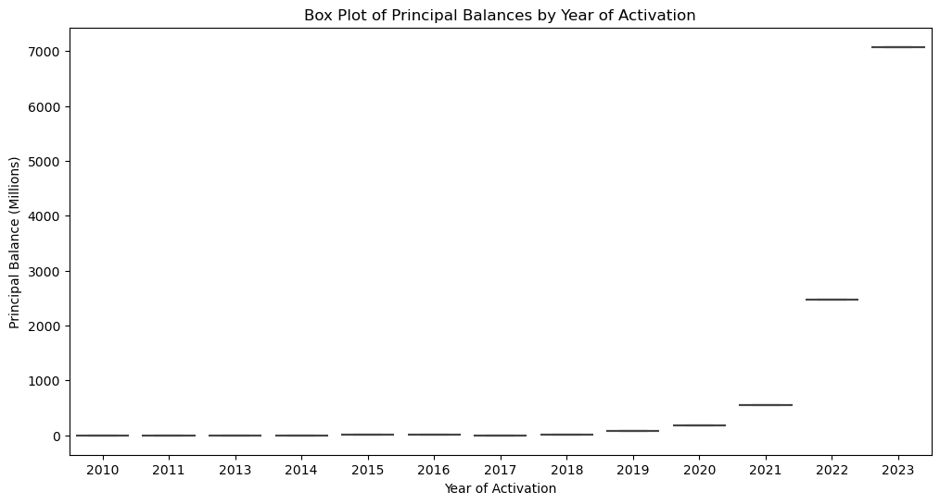
Box plot for 'Principal Balance'

Slide 3
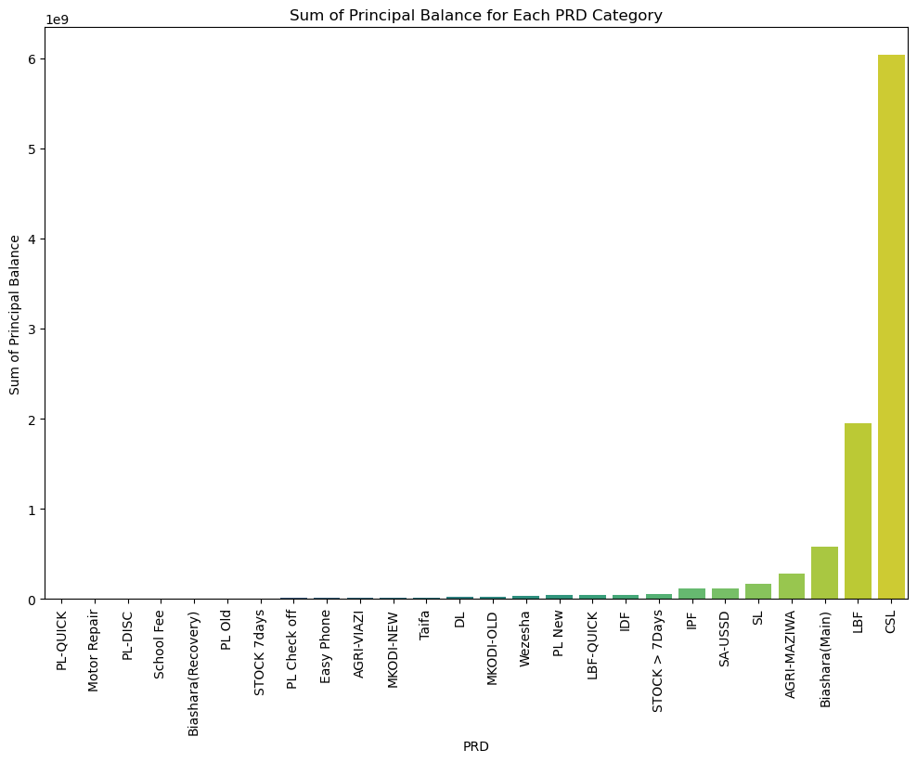
#Sum of principal balance for each product category

Slide 4
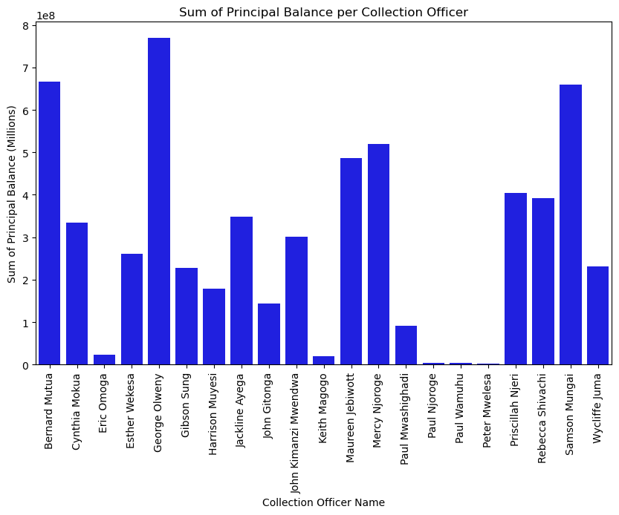
#Pricipal Balance per the collection Officer

Slide 5
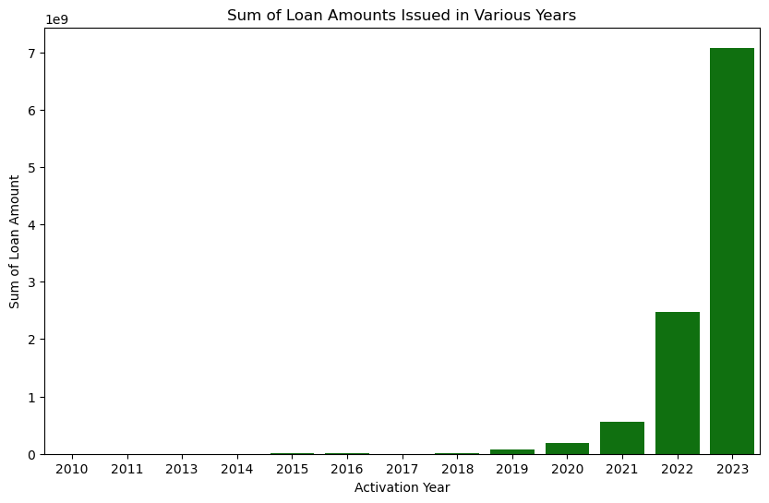
# Trend of loan amounts issued in various years to show if its on the upward trend or downward trend

Slide 6
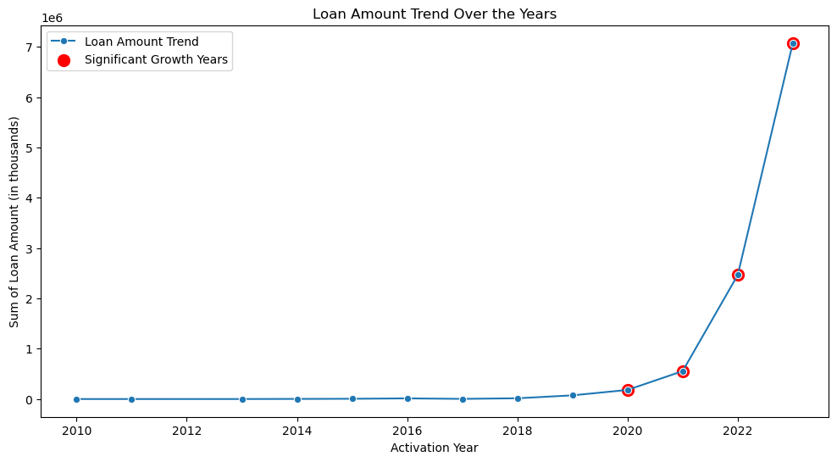
#Loan Amounts Trend over the years

Slide 7
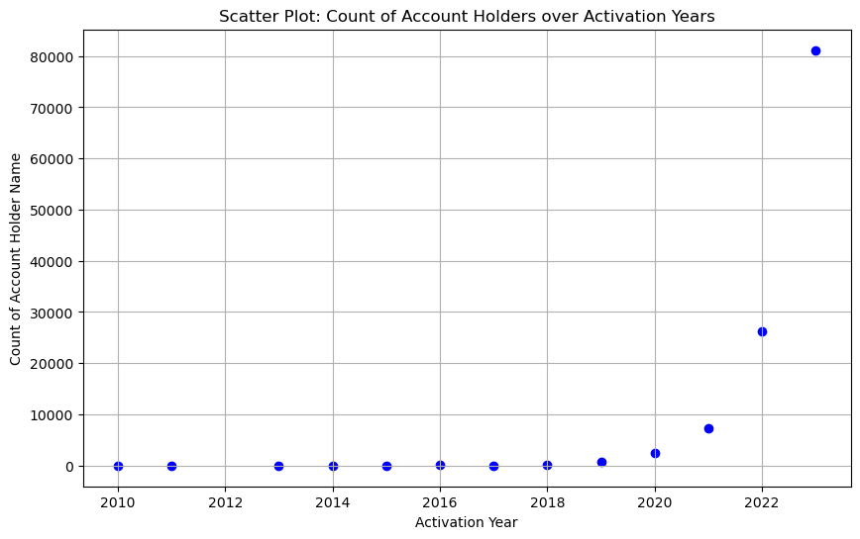
#Trend Count of Account holders over the years

